Slide 1
Knowledge Graphs
Dave Touretzky
Read Mitchell et al. (2018)

Slide 2
What is a knowledge graph?
Summarized from Wikipedia:
A representation of categories, properties, and relations between the concepts and entities that make up a domain.
Some would call this an ontology.
But knowledge graphs often contain large volumes of factual data with less formal semantics than a proper ontology.
In some contexts: any knowledge base represented as a graph.

Slide 3
Who constructs knowledge graphs?
Google
Amazon
Microsoft
Bloomberg (business intelligence)
National Cancer Institute (part of NIH)
National Center for Biomedical Ontology (funded by NIH)
Many others...

Slide 4
Examples of specialized knowledge graphs
Health / life sciences (health-lifesci.schema.org)
Earth science
Agriculture
NCI Enterprise Vocabulary Services (evs.nci.nih.gov)

Slide 5
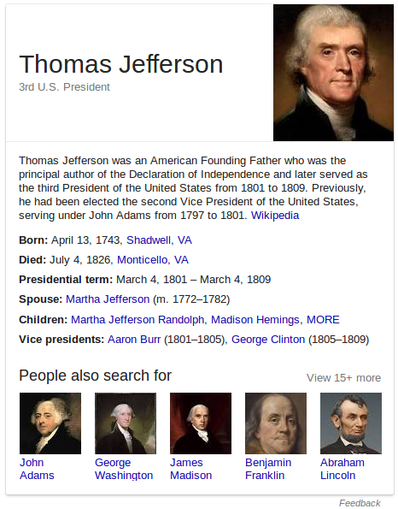
Knowledge panels in Google search results
The panels are generated from what’s called the Google Knowledge Graph.
Data comes from Wikipedia, CIA World Factbook, and other online sources.
May be responsible for a significant decline in Wikipedia visits.
As of Oct. 2016, held 70 billion facts.

Slide 6
Sampling of Google Knowledge Graph entities
Book
BookSeries
EducationalOrganization
Event
GovernmentOrganization
LocalBusiness
Movie
MovieSeries
MusicAlbum
MusicGroup
MusicRecording
Organization
Periodical
Person
Place
SportsTeam
TVEpisode
TVSeries
VideoGame
VideoGameSeries
WebSite

Slide 7
Google Knowledge Graph API Access
import json import urllib api_key = open('.api_key').read() query = 'Taylor Swift' service_url = 'https://kgsearch.googleapis.com/v1/entities:search' params = { 'query': query, 'limit': 10, 'indent': True, 'key': api_key, }
url = service_url + '?' + urllib.urlencode(params) response = json.loads(urllib.urlopen(url).read()) for element in response['itemListElement']: print element['result']['name'] + ' (' + str(element['resultScore']) + ')'

Slide 8
Partial result
{ "@type": "EntitySearchResult", "result": { "@id": "kg:/m/0dl567", "name": "Taylor Swift", "@type": [ "Thing", "Person" ], "description": "Singer-songwriter", "image": { "contentUrl": "https://t1.gstatic.com/images?q=tbn:ANd9GcQm...", "url": "https://en.wikipedia.org/wiki/Taylor_Swift", "license": "http://creativecommons.org/licenses/by-sa/2.0" }, "detailedDescription": { ...

Slide 9
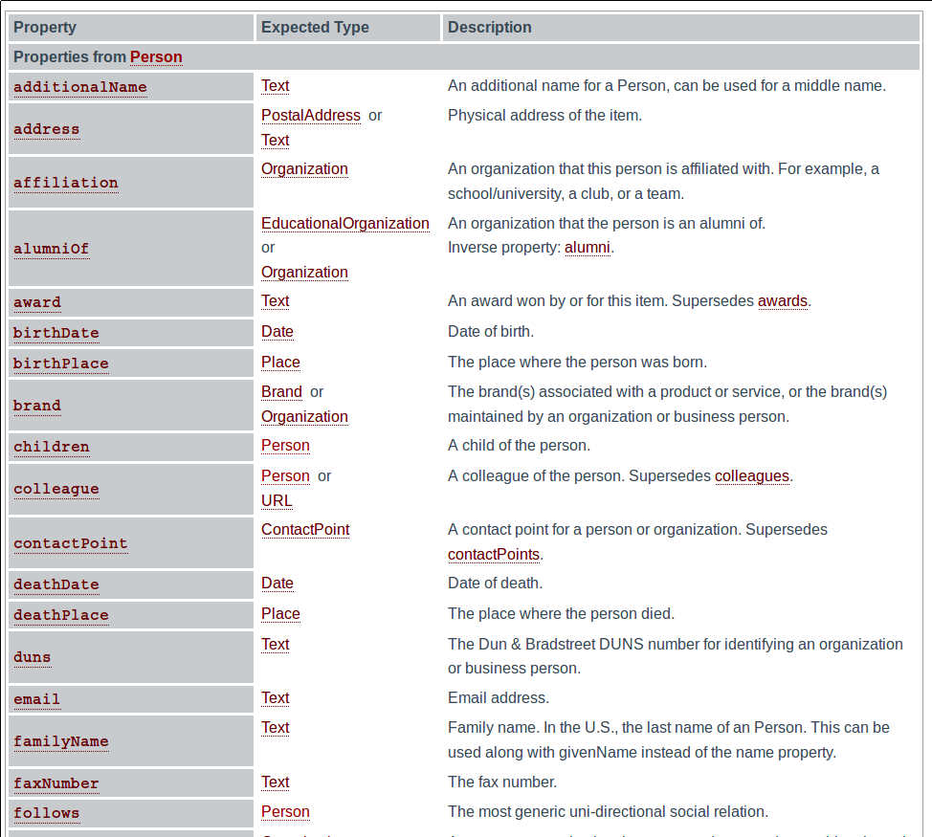
“Person” schema
at schema.org
Person
Canonical URL: http://schema.org/Person
Thing > Person
A person (alive, dead, undead, or fictional).
Usage: Over 1,000,000 domains

Slide 10
The semantic web
Term coined by Tim Berners-Lee.
Common framework for exchange of data across application, enterprise, and community boundaries.
HTML defines how text should look when presented to humans.
Semantic web markup defines how information should be organized to be interpretable by machines.
“Ontolgy engineer” is a job description now.

Slide 11
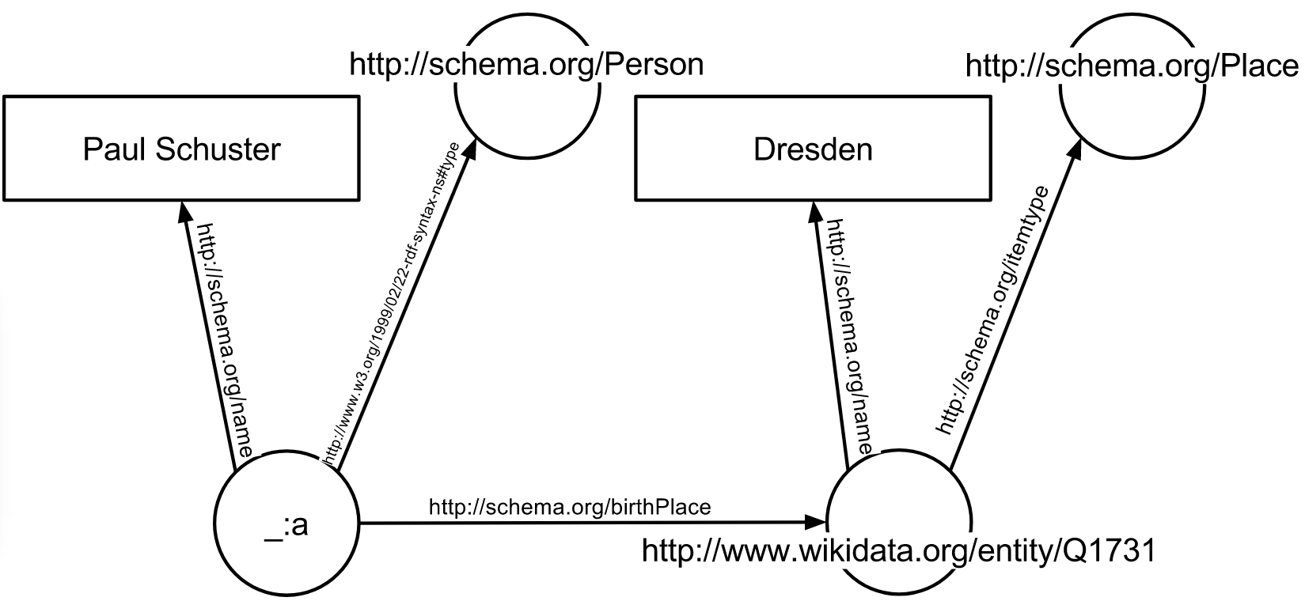
Paul Schuster was born in Dresden

Slide 12
Paul Schuster was born in Dresden

Slide 13
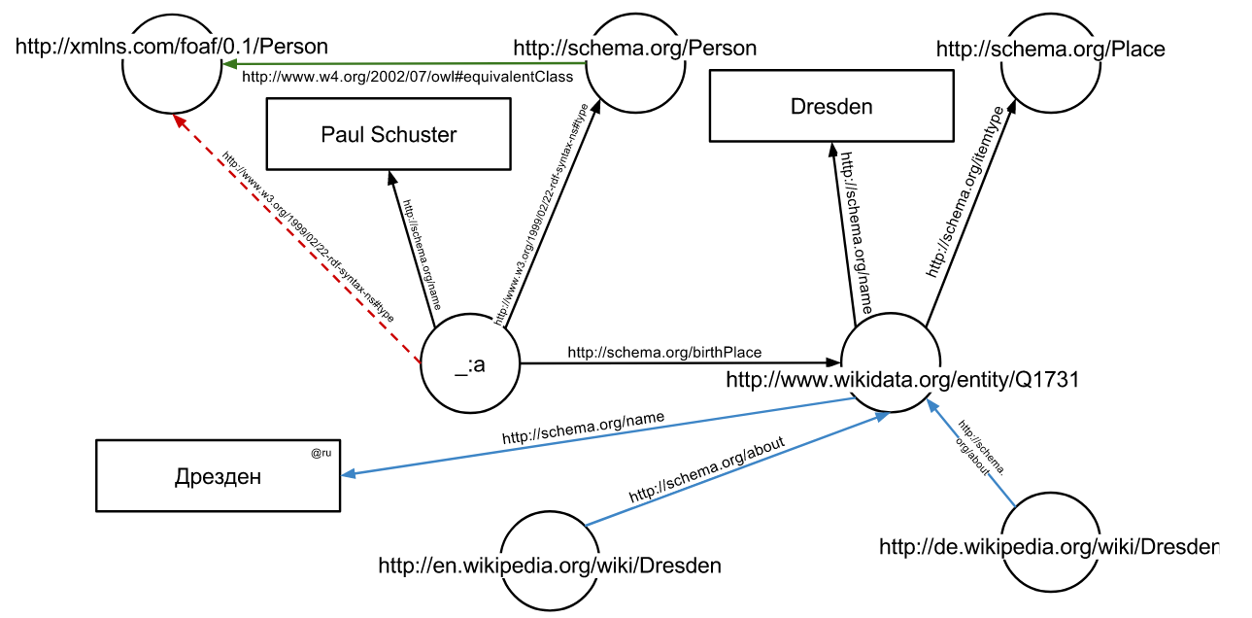
Extending with information from other sources
Ontology of personal relationships
German Wikipedia entry
“Dresden” in Russian

Slide 14
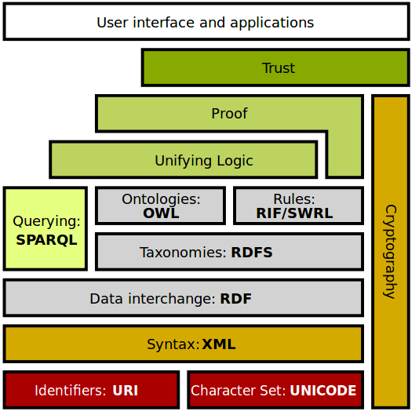
The semantic web stack
OWL: Web Ontology Language
RDF: Resource Description Framework RDFS: RDF Schema
SPARQL: query language
URI: Uniform Resource Identifier

Slide 15
Building a knowledge graph through machine learning

Slide 16
NELL: Never-Ending Language Learning
Tom Mitchell et al. (CMU), 2010 to present.
Learning to “read the web” 24 hours/day.
Training data includes a collection of 1.2 billion web pages.
Access to additional data through search engine APIs (100K calls/day).
KB has 2.8 million instances over 1186 different categories.
KB is freely available for download.
You can help train NELL via Twitter.

Slide 18
Motivation for NELL
Thesis: “we will never truly understand human or machine learning until we can build computer programs that, like people,
Learn many different types of knowledge or functions
From years of diverse, mostly self-supervised experience
In a staged curricular fashion, where previously learned knowledge enables learning further types of knowledge
Where self-reflection and the ability to formulate new representations and new learning tasks enable the learning to avoid stagnation and performance plateaus.”

Slide 19
Basic idea
NELL learns several things:
Categories
Triples: noun phrase 1 - relation - noun phrase 2
New relations
Multiple inference algorithms propose triples and gather evidence for them.
Linguistic information
Word co-occurrence
Image labeling
Etc.
Categories and triples supported by multiple sources of evidence grow in confidence.

Slide 20
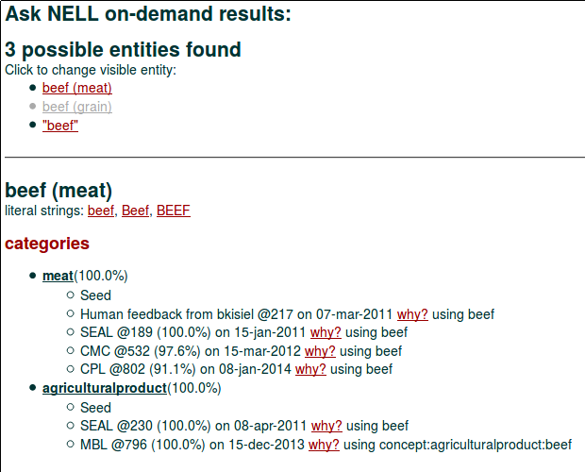

Slide 22
Never-ending learning
Set of learning tasks L = { L_{i} }
Task L_{i} = <T_{i}, P_{i}, E_{i}>
T_{i} is a task <X_{i}, Y_{i}> specifying the domain of a function f_{i}* : X_{i} → Y_{i}
P_{i} is a performance metric P_{i} : f →ℝ
E_{i} is an experience
Coupling contraints C = {<𝜙_{k}, V_{k}>}
𝜙_{k} specifies degree of satisfaction of the coupling constraint among tasks
V_{k} is a vector of indices over learning tasks specifying the arguments to 𝜙_{k}
f_{i}* = arg max P_{i}(f)
Goal: improve the quality of the task functions f_{i} as measured by the P_{i}.
NELL faces over 4100 distinct learning tasks.
f ∊ F_{i}

Slide 23
Category classification tasks
Character string features of the noun phrase: Coupled Morphological Classifier system (CMC)
Distribution of text contexts found around this noun phrase in the 1.2 billion page database: Coupled Pattern Learner system (CPL)
Distribution of text contexts found through active web search (OpenEval).
HTML structure of web pages that mention the noun phrase: Set Expander for Any Language system (SEAL)
Visual images associated with the noun phrase: Never Ending Image Learner (NEIL)
Learned vector embeddings (feature vectors) of the noun phrase: LE (Learned Embeddings)

Slide 24
Learned embeddings of 280 categories

Slide 25
Bedroom, bathroom, and kitchen room items

Slide 26
Relation classification
Does “Pittsburgh” + “US” satisfy the relation CityLocatedInCountry(x,y) ?
There are 461 relations in the ontology.
Four methods are used for relation classification:
Distribution of text contexts from CPL
Distribution of text context from OpenEval
HTML structure from SEAL
Learned vector embeddings from LE

Slide 27
Entity resolution
Functions to classify whether pairs of noun phrases are synonyms.
Noun phrases are kept distinct from the entities to which they refer.
Necessary to deal with polysemy.
“Coach” can be either a person or a vehicle.
Two methods are used:
String similarity
Similarities in beliefs about the entities
NELL learns for each category what are the good types of knowledge to take as evidence for synonymy.

Slide 28
Inference rules among belief triples
Functions that propose new beliefs to be added to the KB.
For each relation, the corresponding function is represented by a collection of restricted Horn Clause rules learned by the Path Ranking Algorithm (PRA)

Slide 29
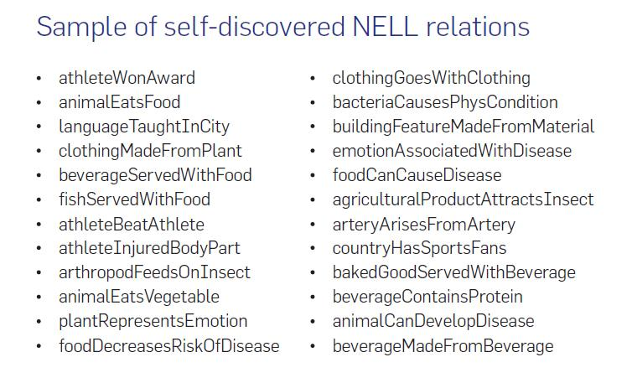

Slide 30
Coupling constraints
Multi-view co-training coupling: do alternative methods for (1) classifying noun phrases into categories or (2) classifying noun phrase pairs into relations, yield the same conclusions?
Subset/superset coupling: when a new category is added, find its parents. Make sure that (∀x) C₁(x) ⇒ C₂(x)
Multi-label mutual-exclusion coupling: when a new category is added, find categories disjoint from it. Makes sure that (∀x) C₁(x) ⇒ ¬C₂(x)
Coupling relations to the argument types: a relation x-R-y requires arguments of the appropriate category for x and y.
Horn clause coupling: when NELL learns a rule of form (∀x,y,z) R₁(x,y) ∧ R₂(y,z) ⇒ R_{e}(x,z) this serves as a coupling constraint between the R_{i} and category labels.

Slide 31
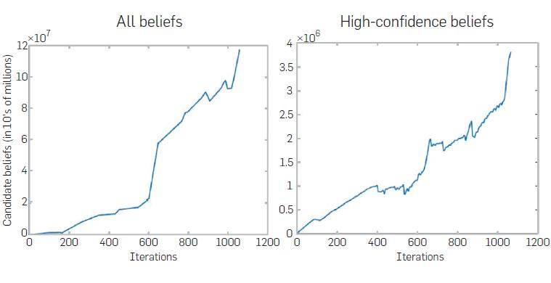
Growth of the KB over time

Slide 32
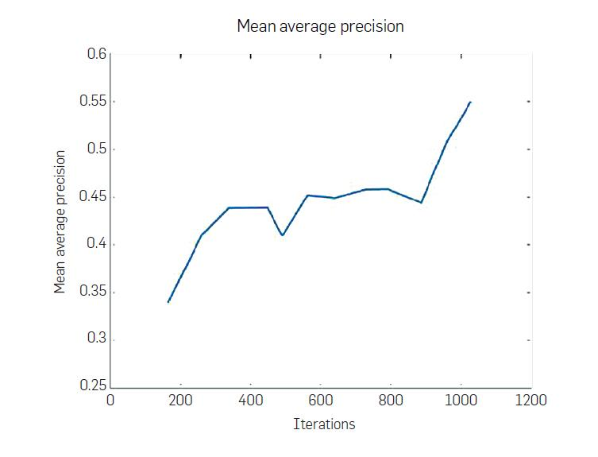
Performance improvement over time
Mean average precision over the 1000 most confident predictions for a sample of 18 categories and 13 relations in NELL’s ontology.

Slide 33
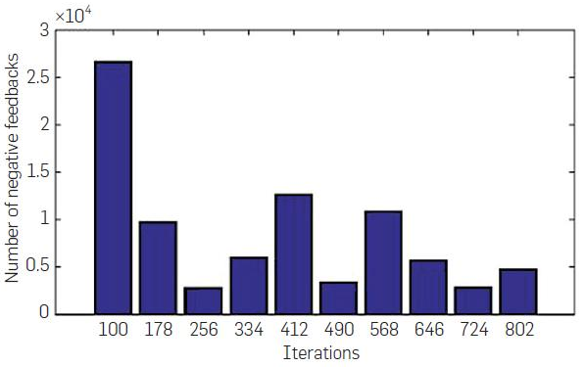
Human correction of NELL
Average 2.4 negative feedback items per month per predicate.

Slide 34
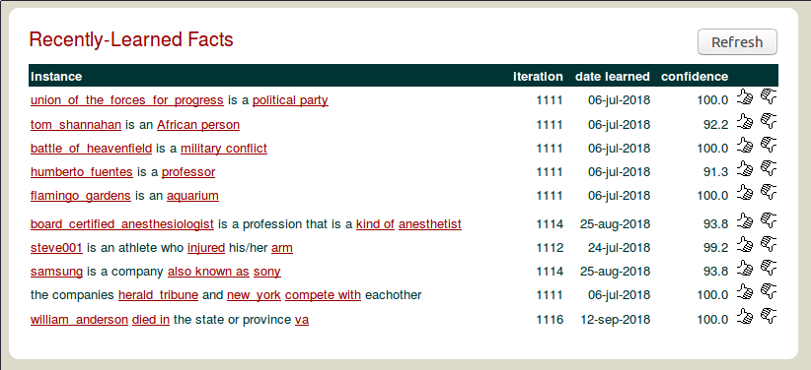

Slide 35
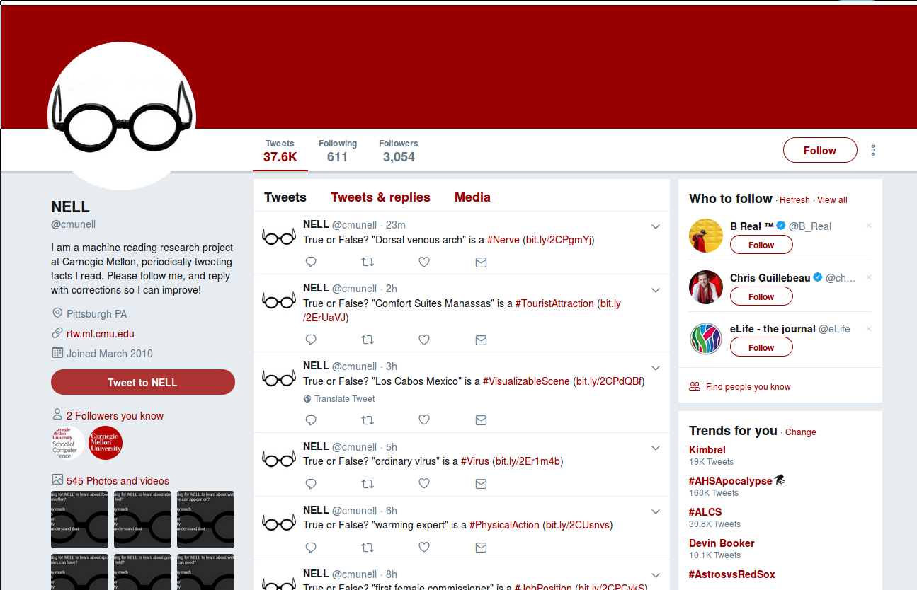

Slide 36
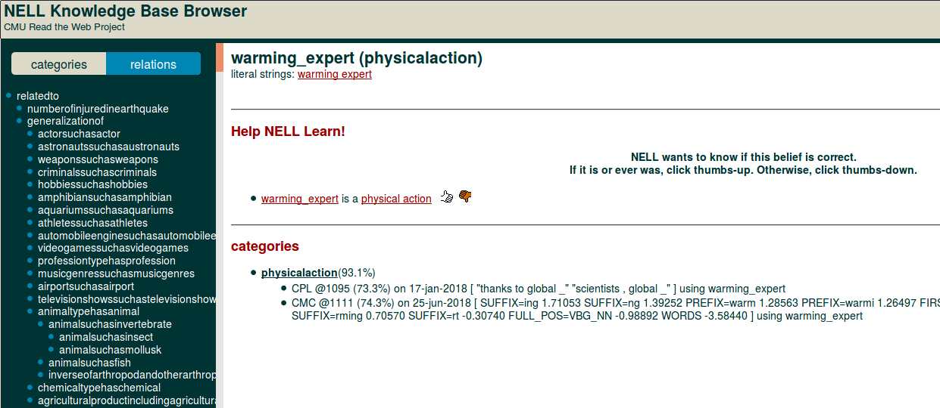

Slide 37
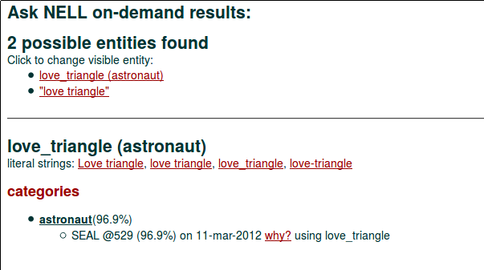

Slide 38
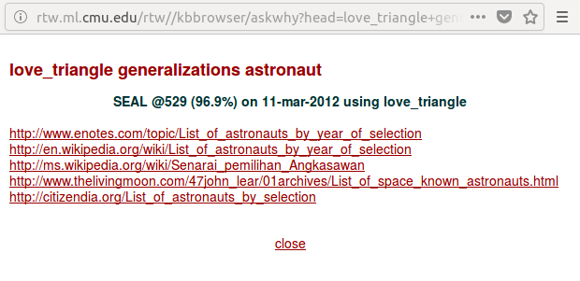

Slide 39
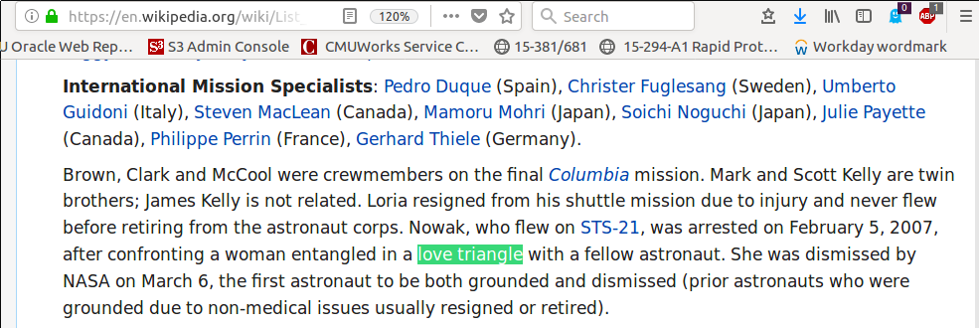

Slide 40
Summary
Knowledge engineering is now a career path.
Many commercial uses for ontologies and knowledge graphs.
Connecting information via the web is enabling powerful reasoning and inference processes.
Machines need to learn more than facts. They need to learn how to learn. NELL is a step in this direction.

